Slide 1

TIC TAC TOE USING ARTIFICIAL INTELLIGENCE
(OPEN SOURCE TECHNOLOGY)
Made by :
SAMARTH SHAHU (53)
PRITHVI SHARMA (54)
V.E.S. INSTITUTE OF TECHNOLOGY
DEPARTMENT OF EXTC
THIRD YEAR SEM V D14A
2019-2020

Slide 2
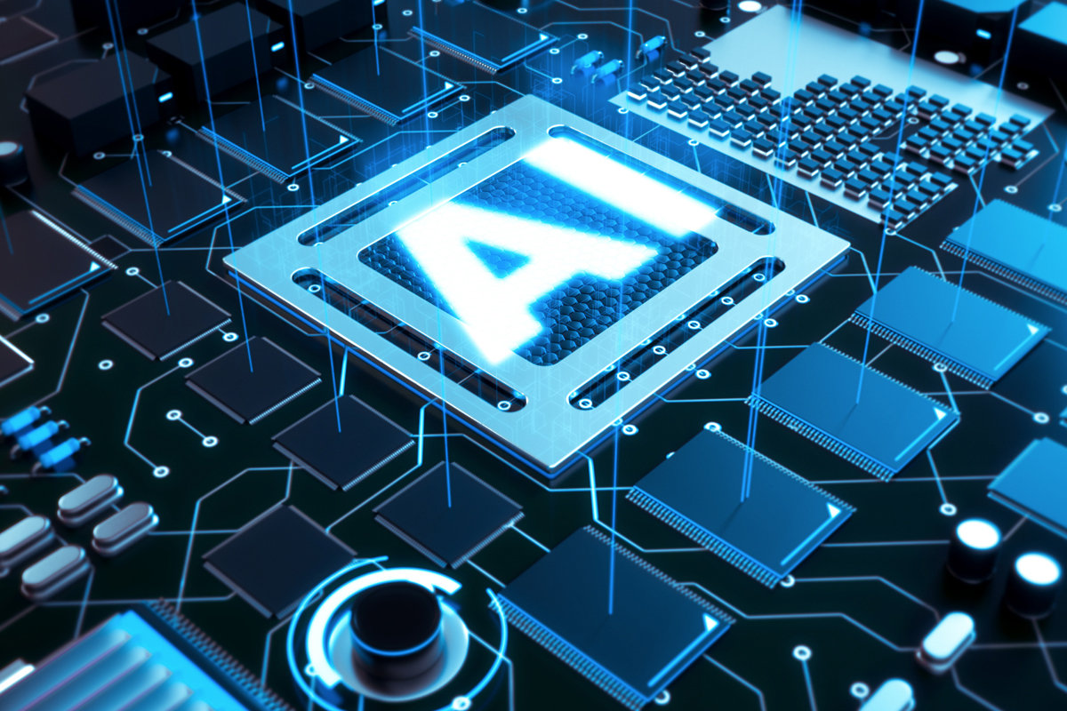
ARTIFICIAL INTELLIGENCE
AI is the simulation of human intelligence by machines.
It analyses the environment and takes actions that maximizes it’s chances of success.
It often revolves around the use of algorithm which are data driven.
Examples – Siri

Slide 3
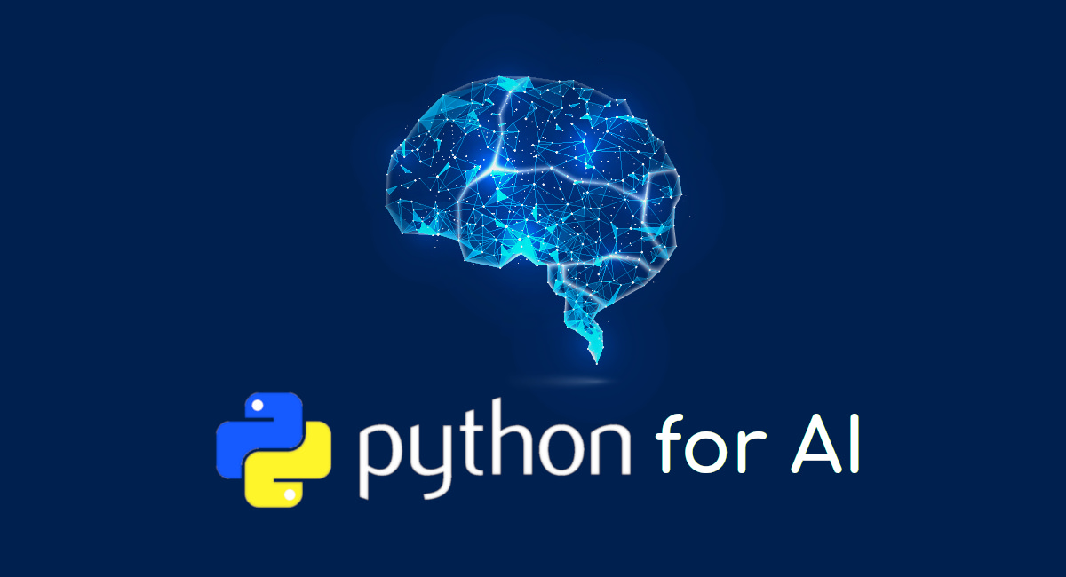
Why Python?
Object oriented language hence easy to program.
It can be easily used in frontend by its pre-installed plugins .
Rich Library.
It has a huge tech support.

Slide 4
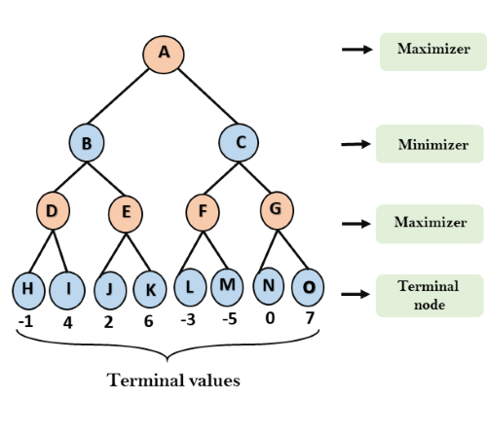
MINIMAX ALGORITHM
A kind of backtracking algorithm used in decision making.
It is also used in the game theory to find the optimal move for a player, assuming that the opponent also plays optimally.
Used in two player games such as tic-tac-toe and chess.

Slide 5
PROJECT ALGORITHM
If someone has a “threat” (i.e. two in a row), take the remaining square. Otherwise,
If a move “forks” to create two threats at once, play that move. Otherwise,
Take the centre square if it is free. Otherwise,
If your opponent has played in a corner, take the opposite corner. Otherwise.
Take an empty corner if it exists. Otherwise,
Take any empty square.

Slide 6
WORKING PROCEDURE
Calling pygame for easier display.
Declaring frontend shapes and colors.
Individualizing tiles and their work area.
Calling AI for appearance of opponent tiles.
Giving opponent info to the AI.
Producing a box with perfect dimension.
To show the difference, giving an option of “Human vs Human” by providing both block control to user and only running thr game algorithm and not AI.

Slide 7
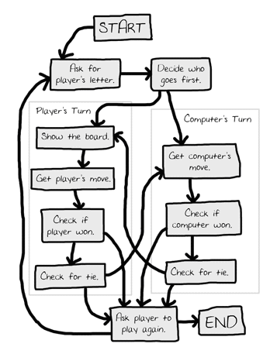

Slide 8
APPLICATIONS OF AI
IMAGE RECOGNITION
SPEECH RECOGNITION
CHATBOTS
NATURAL LANGUAGE GENERATION
SENTIMENT ANALYSIS

Slide 9
REFERENCES:-
https://www.uswitch.com/mobiles/guides/history-of-mobile-phones/
https://www.seminarsonly.com/Labels/4g-Technology-Features.php2
https://advergize.com/edu/10-advantages-technology-modern-life/
https://turbofuture.com/misc/Disadvantages-of-Digital-Technology

